Slide 1

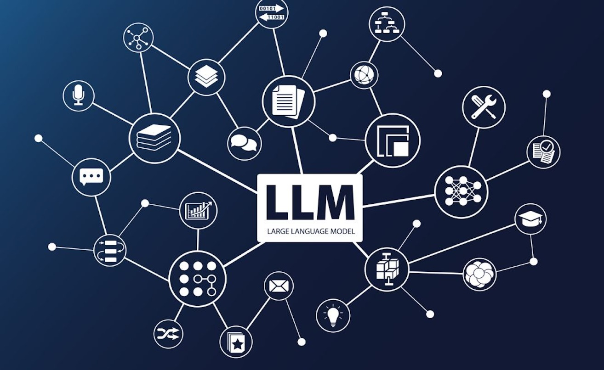
LLM Model News research Tool
Sit Dolor Amet
Bharti Jagyasi

Slide 2

Introduction
This project focuses on building a streamlined, LLM-powered news research tool using:
Lang Chain for LLM
- Groq for high-speed model inference
- Stream lit for an interactive web UI
It enables users to extract and analyze news data effectively

Slide 3

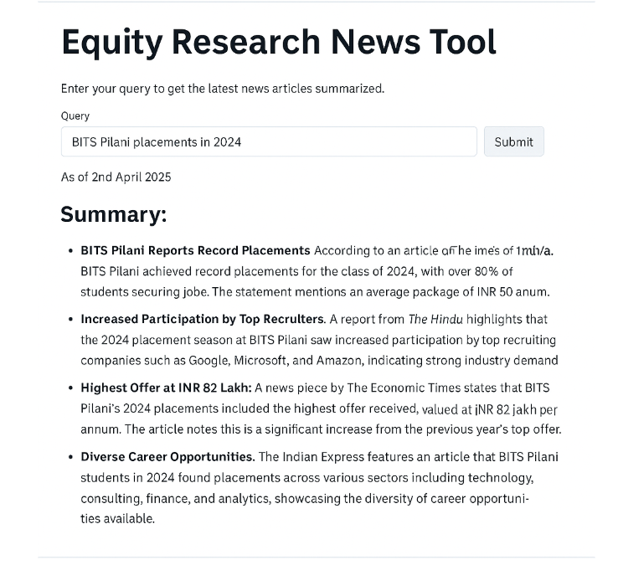
News API Response-Streamlit

Slide 4
Conclusion
* LLMs are effective for summarizing real-time news
* Streamlit is a user-friendly choice for rapid prototyping
* Future scope: sentiment analysis, email alerts, filtering, trend clustering
Thank You

